Slide 1

Smart Attendance Tracking System: Requirement Gathering
This report documents the requirement gathering process for a Smart Attendance Tracking System, integrating geofencing and facial recognition. Traditional attendance methods are prone to errors, so Group 7 initiated this project to modernize academic operations. We employed surveys, interviews, focus groups, brainstorming, reverse engineering, and prototyping to uncover user needs and technical requirements. Data cleaning ensured the accuracy of insights, guiding the design and feature set of the proposed system.

Slide 2
Stakeholder Identification: Ensuring Comprehensive Requirements
Importance
Identifying Key Players
Identifying stakeholders ensures comprehensive and accurate requirements collection, reduces project failure risks, addresses concerns proactively, and considers all perspectives in decision-making, leading to higher acceptance and satisfaction.
Stakeholder identification is critical in software development. A stakeholder is anyone with an interest, influence, or investment in the application's outcome. Identifying the right stakeholders ensures alignment with user needs, business goals, technical constraints, and regulatory compliance.
A stakeholder is someone who:
Is affected by the project or application.
Has influence over the project (positively or negatively).
Provides resources for the project (time, money, technical input).
Uses or interact with the final product

Slide 3
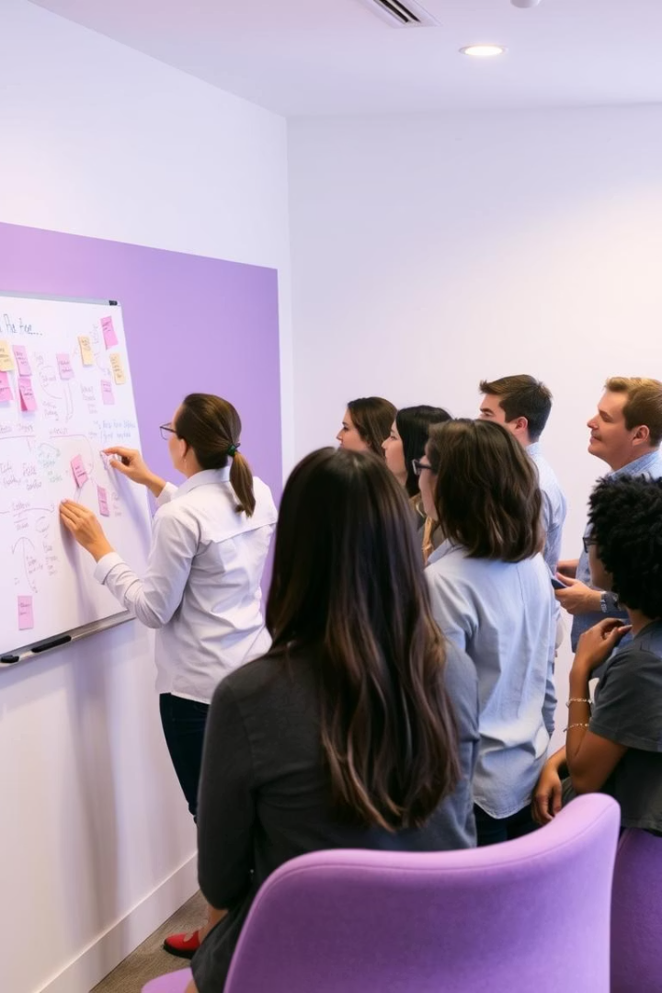
Stakeholder Identification: Ensuring Comprehensive Requirements
Stakeholder identification process
tools and Techniques Used
Brainstorming sessions within our project team to list potential user groups.
Stakeholder Mapping using the Power-Interest Grid to visualize and prioritize stakeholders.
RACI Matrix to define the roles and responsibilities of different groups.
1. Analyzing the project scope.
2. Listing potential stakeholders
3. Categorizing stakeholders
Engaging with stakeholders

Slide 4
Identified Stakeholders and Their Roles
Stakeholder | Role | Interest Level | Responsibilities/Concerns
Students | End users | High | Use the app to check in for classes; ensure face data is secure and app is easy to use.
Lecturers | Secondary users and validators | High | Monitor attendance records, validate unusual entries, and generate attendance reports.
IT Department | Technical stakeholders | High | Responsible for system deployment, backend infrastructure, and integration with school LMS.
University Admin | Key stakeholders/decision makers | High | Approve the system, allocate budgets, ensure legal compliance, and enforce its usage policy.
Parents/Guardians | Indirect stakeholders | Medium | May view attendance reports; expect reliability and transparency.
Data Protection Office | Regulatory and compliance authorities | High | Ensure compliance with privacy laws such as data consent, storage, and usage of biometrics.
Face Recognition API Providers | Third-party services | Medium | Provide face detection and matching services; reliability and uptime are critical.
Geolocation Services | Infrastructure providers | Medium | Provide GPS and geofencing data; crucial for verifying presence in the target location.
Challenges Faced in Stakeholder Identification
Overlooking less obvious or indirect stakeholders like parents and service API providers.
Misjudging the level of influence of some users Communication barriers during early interviews
faculty members who were initially skeptical about using GPS and facial data for attendance.
Stakeholder identification was a
foundational activity that informed the rest of our
requirement gathering process

Slide 5
Requirement Gathering Techniques: A Multifaceted Approach
1
Surveys and Questionnaires
2
Interviews
Collect quantitative and qualitative data from a large audience. Key areas targeted included current challenges, technology familiarity, and data privacy concerns.
Insights
Over 87% of students and 100% supported mobile-based attendance.
One-on-one conversations to gather detailed insights about needs, challenges, and expectations. Specificity, open-ended questions, and confidentiality were prioritized.
Insights
Some student preferred finger print to facial recognition and lecturers wants the ability to initiate sessions.
3
Brainstorming
Collaborative sessions to generate innovative ideas and identify challenges. Mind mapping, silent brainstorming, and round-robin techniques were used.

Slide 6
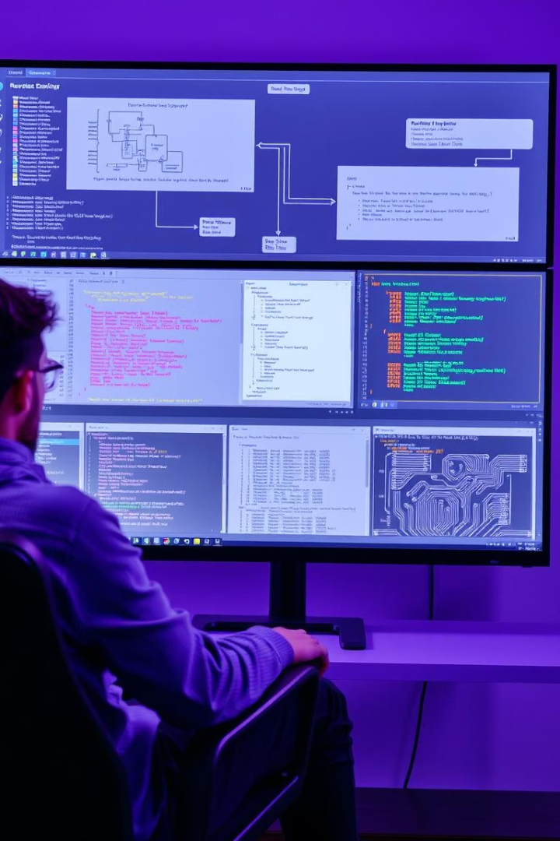



Reverse Engineering: Learning from Existing Systems
Understanding Existing Systems
Analyze architecture and workflows of existing attendance systems, including source code, key features, and documentation.
Geofencing Implementation Analysis
Examine GPS data processing, accuracy evaluation, and performance optimization for location-based attendance verification.
Facial Recognition Technology Analysis
Study algorithms, training datasets, and security measures to optimize facial recognition accuracy and ensure secure user identification.

Slide 7

Focus Groups: Gathering Qualitative Insights
Purpose
Process
Gather detailed opinions, priorities, and emotional responses from students and instructors about existing attendance systems and the proposed solution.
Form groups of 6–8 participants by role. A facilitator led discussions on ease of use, trust in biometric systems, and concerns about tracking.
Key Takeaways
Students favored self-check-in with restrictions. Instructors wanted real-time alerts for missed attendance or anomalies.

Slide 8
Prototyping: Visualizing the System
Overview
1
1
Create early visual representations of the system to validate user expectations.
Process
2
Show paper-based designs to stakeholders. Simulate scenarios and document feedback.
Findings
3
Users wanted minimal clicks for check-in and feedback indicators. Instructors requested color-coded attendance indicators.

Slide 9



Data Gathering: Structuring Information
Primary Data collected
Facial Recognition Training Data
School Attendance Record History Format
Geolocation Data for Geofencing
Data gathering is critical, especially for facial recognition and geofencing. Primary data components include facial recognition training data, school attendance record history format, and geolocation data for geofencing. The objective is to collect diverse image data and standardize the database schema for recording student attendance.

Slide 10
Data Cleaning: Ensuring Accuracy and Reliability
Data cleaning is essential to ensure the reliability and accuracy of collected data. This process involves identifying and correcting issues such as missing values, inconsistent formats, and incorrect entries. Effective data cleaning is crucial for deriving meaningful insights and building reliable dashboards for our smart attendance system.
Why data analysis is necessary for this project
3
1
2
Helps prepare for automation and
machine learning
Improve accuracy of analysis
Enhance understanding and
user experience

Slide 11
Methods , tools and processes used in cleaning
Method | Description
Trimming and Formatting | Removed extra spaces, corrected typos, and standardized capitalization.
Deduplication | Detected and removed repeated entries based on identical timestamps and answers.
Standardization | Unified terms for institutions, roles, devices (e.g., “android” → “Android”).
Translation & Harmonization | Translated French responses into English and standardized vocabulary.
Data Type Conversion | Transformed categorical ratings to numerical format; parsed dates as datetime.
Handling Missing Values | Filled blanks with defaults (e.g., “Unknown”) or dropped incomplete rows.
Encoding Fixes | Ensured UTF-8 encoding to prevent character corruption.
Normalization | Re-aligned nested location or institution data into consistent fields.
Tool / Platform | Use in Cleaning Process
Microsoft Excel | Initial exploration, filtering blanks, removing duplicates in small datasets.
Python (Pandas) | Comprehensive data wrangling: missing value handling, normalization, encoding correction, transformations.
OpenRefine | Clustered messy institution names; harmonized free-text entries using reconciliation features.
R (tidyverse) | Used selectively for reshaping and string manipulation.
SQL | Filtering data subsets, performing joins, and checking constraints in structured datasets.

Slide 12






User Reluctance Assessment: Addressing Concerns
Location Tracking Fears
Increased Battery and Data Usage
Privacy of Biometric Data
Assess user reluctance to identify factors causing hesitation, especially with sensitive data. Key areas include privacy of biometric data, location tracking fears, and increased battery usage

Slide 13
Mitigation Strategies
Mitigation strategies involve transparent consent forms, robust deep learning models, and efficient location detection.
Privacy (Biometric & GPS)
Battery/Data Usage
- Store all facial data in encrypted format using AES-256. - Include transparent consent forms during registration. - Clearly explain when and how location data is used (e.g., only during class check-in).
- Use Google’s Fused Location API for efficient location detection. - Allow offline check-in with delayed syncing when online
Accuracy of Face Recognition
Use robust deep learning models (e.g., using TensorFlow + OpenCV).
- Include fallback mechanisms (e.g., manual verification or secondary checks).

Slide 14
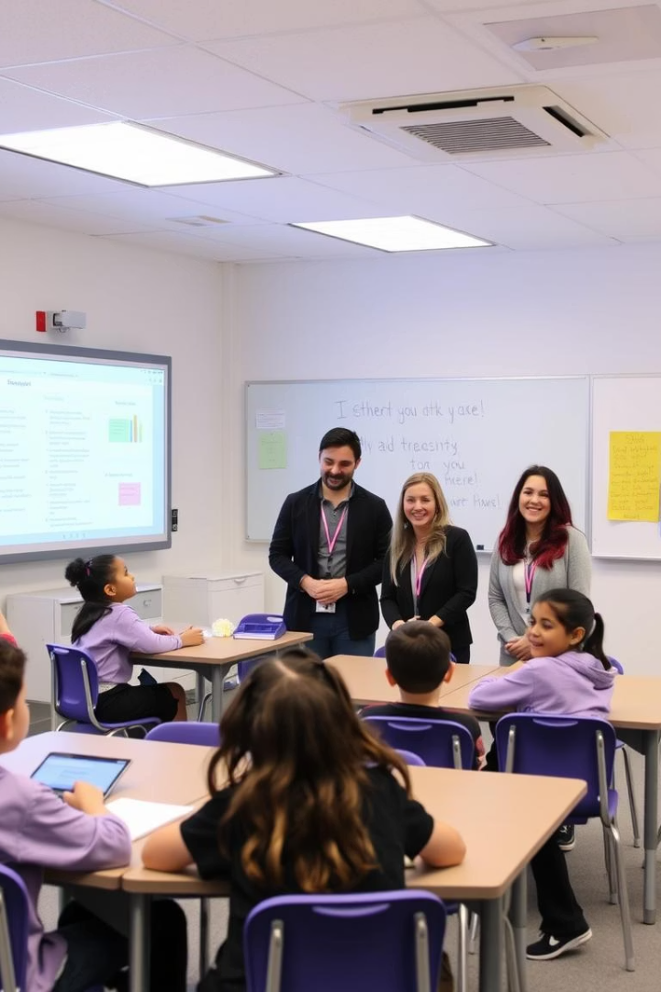
Conclusion: Building a User-Driven System
The success of any system hinges on aligning with user needs. Our comprehensive requirement gathering process has deeply understood stakeholder expectations and pain points. By investing in structured data collection and meticulous data cleaning, we ensured decision-making was based on reliable information. This report serves as the cornerstone for a smart, scalable, and context-aware attendance solution.

